Slide 1
Business Model Title
※ This Business Model Format is designated as example for SOItmC & DEMI of the UNINA. 2018 with IFKAD Conference, but just refer to this guideline and please fill the contents below when writing your Business Model Presentation.
- The Business Model Presentation for 2018 DEMI of the UNINA. 2018 with IFKAD conference should be about PPT 15 pages.
First Author Name
Position (Ex. Prof. Researcher, Ph.D., Master, CEO, and etc.), Affiliation (Ex. University, Institute, Company), Nationality
Email: abc@defg.hig
Second Author Name
Position (Ex. Prof. Researcher, Ph.D., Master, CEO, and etc.), Affiliation (Ex. University, Institute, Company), Nationality
Email: abc@defg.hig

Slide 2

Book Reference - Business Model Design Compass
*Please refer to the “Business Model Design Compass” book.
*Please refer to Page 158, 167, 183, 203, 221 in this book.

Slide 3
Introduction of firm(firm name)-Ⅰ
Firm(Name) was established on….

Slide 4
Introduction of firm(firm name)-Ⅱ
Now the firm(Name) is…

Slide 5
Innovative case of the firm(firm name)-Ⅰ
Innovative case one of the firm is…

Slide 6
Innovative case of the firm(firm name)-Ⅱ
Innovative case two of the firm is…

Slide 7
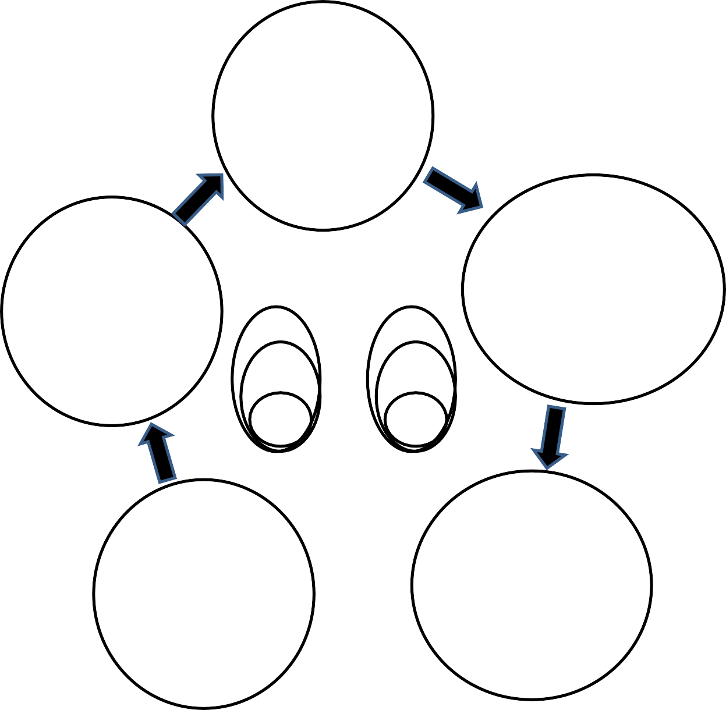
Business Model Design
Who demand
our firms additional
or different things ?
Creative and new Customer Segmentation
When and Where do you meet new or
additional customer?
New or additional way to meet customer
- New Channels
What
should be the countermeasures against the demand or expectation?
Catch new Value Proposition from upstream downstream supply chain
Technology
Market
Social
Market
knowledge
- New Customer
Relationships
Protectable knowledge
Potential
Market
patent
Market
How should firms recombine technologies and market ?
New or additional
Technological System
, motivated by users (customers, suppliers, partners, internals etc.
Why
should firms do reconfiguring process?
Cost and Revenue by revised or new processes and points

Slide 8
Business Model Design
Who(Customer Segmentation) (2 pages)
*Concretely define a customer
Main Considerations:
- Persona
- Noncustomer
- Adjacent market
- Overshooting

Slide 9
Business Model Design
2. What(Value propositions) (2 pages)
*Resolve a problem, provide a concrete value, meet a desire
Main Considerations:
Minimum viable product
- Feedback
- Pivot

Slide 10
Business Model Design
3. How(Technical System) (2 pages)
*Concrete system that creates value by combining technology and the market
Main Considerations:
Key resources
- Key activities
- Key partnerships

Slide 11
Business Model Design
4. Why(Revenue and cost) (2 pages)
*Cost structure and contents, profit structure and contents
Main Considerations:
Revenue Streams
- Cost Structure

Slide 12
Business Model Design
5. When and Where(Customer meeting) (2 pages)
*How to meet a customer, how to form customer relationships
Main Considerations:
Channels
- Customer relationships

